Slide 1





FAKE NEWS DETECTION USING MACHINE LEARNING AND DEEP LEARNING
IDENTIFYING FAKE AND REAL NEWS ARTICLES WITH NLP MODELS
Bobi Barua
ID: 2104010202165

Slide 2




Introduction
Fake news has become a major issue in today’s digital media landscape.
It spreads misinformation and affects public perception and trust.
Manual detection is challenging due to the massive volume of online content.
This project applies Machine Learning and Deep Learning to detect fake news automatically.

Slide 3




Objective
Build an automated system to detect fake and real news articles.
Compare the performance of Machine Learning and Deep Learning models.
Evaluate models based on accuracy, reliability, and generalization.
Deploy the best-performing model on Streamlit Cloud

Slide 4

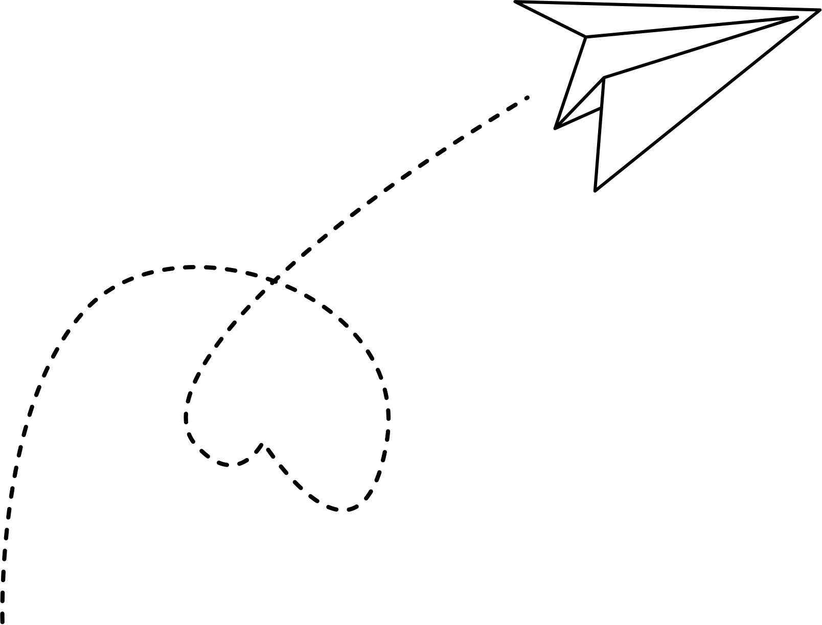




Dataset Overview
Source: Kaggle – Fake and Real News Dataset (by Clément Bisaillon)
Files : Fake.csv and True.csv
Total Records: 44,898 news articles
Classes:
Fake News → 0
Real News → 1
Columns: title, text, subject, date

Slide 5
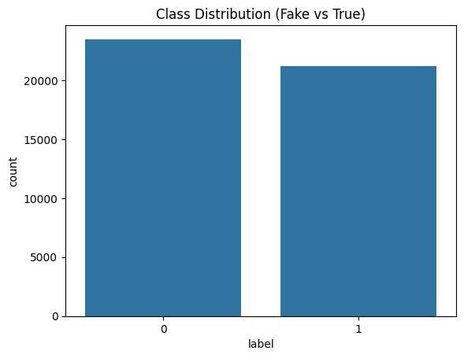

Data Visualization
Class Distribution
0(Fake)- 23481
1(True)- 21417

Slide 6

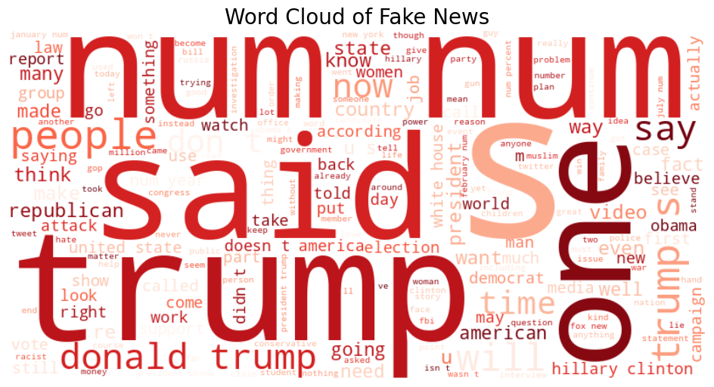
Data Visualization

Slide 7



Methodology
Merge & Load Data
1
2
Feature Engineering
3
Data Preprocessing

Slide 8

Methodology
4
Model Development
Machine Learning Models:
Logistic Regression
Naive Bayes
Random Forest
Deep Learning Models:
LSTM
BiLSTM
GRU
5
Model Evaluation
6
Deployment

Slide 9




Data Preprocessing
Removed duplicates and null/empty rows
Cleaned text: URLs, punctuation, digits, stopwords
Normalized text to lowercase
Combined title and text → full_text
Tokenized and converted to sequences
Padded sequences for Deep Learning models

Slide 10


Feature Engineering
TF-IDF Vectorizer (max_features=50,000)
Extracts useful information from the data
Tokenizer for word indexing
GloVe embeddings (100-dimensional)
Helps model make better predictions.
Padding sequences to MAX_LEN = 300

Slide 11
Model Implementation
Machine Learning Models
Deep Learning Models
Logistic Regression – simple and effective baseline
Naive Bayes – handles text classification probabilistically
Random Forest – ensemble approach for better accuracy
LSTM – captures sequential dependencies
BiLSTM – processes sequences in both
directions
GRU – faster alternative to LSTM with
comparable performance

Slide 12




Model Evaluation
Logistic Regression- 98.10%
LSTM- 98.81%
Machine
Learning
Models
Deep
Learning
Models
Naive Bayes- 94.58%
BiLSTM- 98.84%
Random Forest- 96.63%
GRU- 99.16%

Slide 13
Model Evaluation
Model | Precision | Recall | F1-Score | Accuracy
Logistic Regression | 0.98 | 0.98 | 0.98 | 0.98
Naive Bayes | 0.95 | 0.95 | 0.95 | 0.95
Random Forest | 0.97 | 0.97 | 0.97 | 0.97
LSTM | 0.99 | 0.99 | 0.99 | 0.99
BiLSTM | 0.99 | 0.99 | 0.99 | 0.99
GRU | 0.99 | 0.99 | 0.99 | 0.99

Slide 14


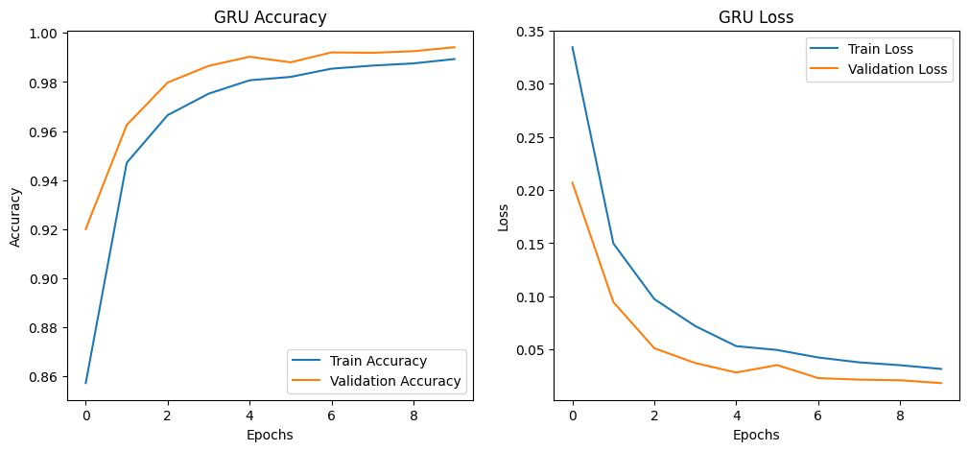

Model Evaluation
GRU outperformed
all other models
efficiently capturing sequential pattern and context in text
Test Accuracy: 99.16%

Slide 15

Deployment
GRU model deployed using Streamlit
Live interface for real-time predictions

Slide 16

Deployment
User can enter news articles
→ system predicts Fake or Real
Displays confidence score alongside prediction

Slide 17
Conclusion
Successfully built an automated
fake news detection system
Comparative Analysis of 6 Machine Learning
and Deep Learning Models
Deployment via Streamlit allows interactive and user-friendly usage
Helps combat misinformation in digital media

Slide 18

Limitations
Relies solely on text data;
ignores images, videos, or external sources.
Language dependency: Currently works
only for English news.
Cannot verify factual correctness;
only predicts based on patterns in training data.

Slide 19
Future Work
Explore transformer-based models
for better context understanding
Extend system to multi-lingual news detection
Real-time monitoring of news streams
from online sources

Slide 20
THANK YOU

